Slide 1


Evolution Strategies for Autonomous Mobile Swarm Robots
Serge Saaybi
Thesis Status update report
TU Delft | 23 March 2021

Slide 2
Thesis Preliminary TOC
Evolution Strategies for Autonomous Mobile Swarm Robots
Introduction
Swarm robotics
Collision avoidance in swarm robotics
Deep Reinforcement Learning for Collision Avoidance
Challenges
Research Statement and Contributions
Thesis Outline
Related Work- State of the art
Deep Reinforcement Learning
Evolution Strategies
Collision Avoidance
Sim2real Gap
An Overview of Swarm Robotics
Motivation and Inspiration
Swarm Design
Behavior-based design methods
Automatic design methods.
Reinforcement Learning
Reinforcement Learning Basics
Deep Reinforcement Learning Basics
Multi-Agent Deep Reinforcement Learning
RL and DRL main algorithms
Collision Avoidance with RL and DRL
Evolution Strategies
Evolution Strategies basics
Evolution Strategies main algorithms
Multi Agent Evolution Strategies
Testbed Design
Requirements
Architecture
Hardware
Software
Implementation
Evolutionary Strategies for collision Avoidance in Swarm Robotics
Theory
Algorithm
Experiments and Results
Results
Comparison with Baselines
Conclusion and Future Work

Slide 3
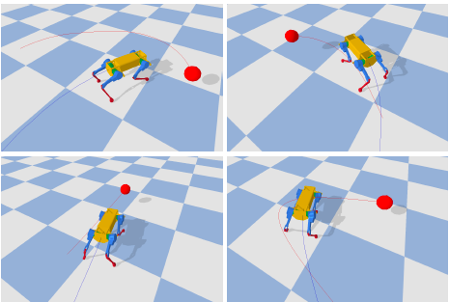
Literature Review
Learning Agile Locomotion via Adversarial Training
A quadruped robot (protagonist) is trained to become more agile by hunting an ensemble of robots which are escaping (adversaries)
Training is done using ESs and more specifically by augmenting CMA-ES to the multi-agent framework
Two training steps:
Outer loop which iteratively trains the protagonist and adversaries
Inner loop for optimizing the policy of each
Policies are represented by feed forward neural networks and are optimized with CMA-ES
This method outperformed MADDPG and MATD3
Notes:
https://www.youtube.com/watch?v=yBUNR_A5lUA&ab_channel=YujinTang
https://www.youtube.com/watch?v=qQ8U2EhjFqQ&t=150s&ab_channel=SwapneshWani

Slide 4
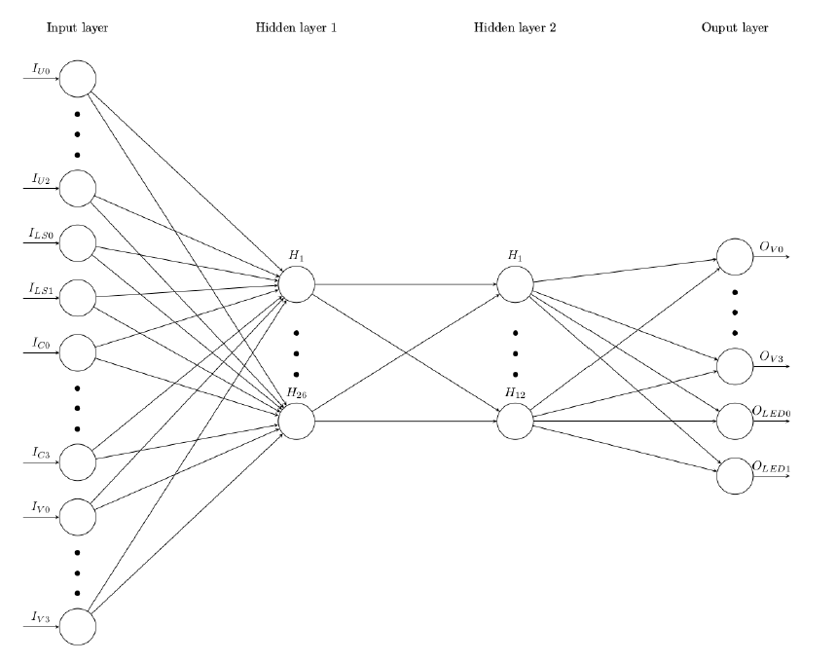
Literature Review
Comparison of Evolutionary Strategies for Reinforcement Learning in a Swarm Aggregation Behaviour
The paper assess the performance of ESs (CMA-ES, PEPG, SES, GA and OpenAI-ES) for multi agent learning in the swarm aggregation task.
This task is about the aggregation of a scattered swarm robot on the environment on a place using their local sensor information.
Robots’ controllers are represented by a Neural network with 2 hidden layers (8 infrared sensors and 4 microphone for inputs and 2 wheels and a speaker as output)
Each robot in the swarm runs the same network thus maintaining collective behaviour.
CMA-ES achieved the best solution for small swarms (5,10 and 20 robots), SES for larger ones (40 robots). OpenAI-ES, needed less generations or training time than other methods, while however requiring more execution steps.

Slide 5
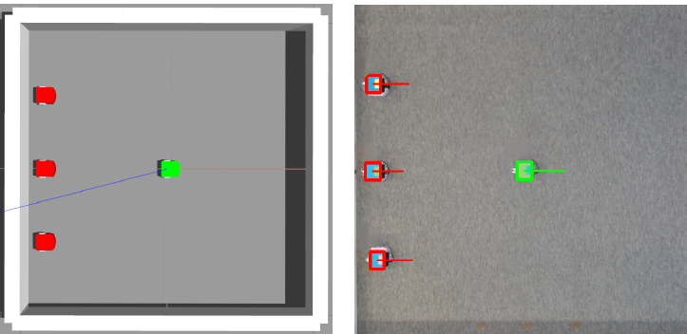
Literature Review
The predator-prey evolutionary robots system: from simulation to real world
Predator-prey system: multiple predators trained to catch a prey
The predator controllers are homogeneous, and are represented by NN - parameters are optimized with openAI-ES, CMA-ES and Bayesian Optimization.
The NN has three inputs (the inverse of the distance from the predator to the other nearest predator, the angle between the orientation of predator and the direction of prey relative to the predator, the distance between the predator itself and the prey), one hidden layer and two outputs for controlling the angular velocities of the two wheels.
The prey's controller follows a simple fixed evasion strategy
The predators showcased a successful collective behavior: moving following a formation and avoiding collisions
CMA-ES has outperformed Bayesian Optimization and OpenAI-ES, as it can better handle noise. The system seemed to be successful in real life as well

Slide 6
Literature Review
Efficacy of Modern Neuro-Evolutionary Strategies for Continuous Control Optimization
XX

Slide 7
Rendering Environment
Unity vs Gazebo
Discrete Deep Reinforcement Learning for Mapless Navigation:
Unity natively supports multi-agent environments hence paving the way for further research targeting multi-agent scenarios.
It is possible to export a model trained in a Unity environment, to the Robot Operating System (ROS) and furthermore, to the real robot
Training the model in the Unity environment is significantly faster than using Gazebo
Model trained in Unity can then be used on Gazebo (using the ROS framework) and on the real robotic platform without additional training.
Simulation of Mobile Robots with Unity and ROS: A Case-Study and a Comparison with Gazebo
The simulation in unity is more detailed and closer to reality than the simulation in Gazebo
Quantitative benchmarks showed a similar behaviour to reality in the Unity simulations
MuJoCo/ PyBullet
Unlike simulations that rely on game engines like Unreal Engine 4 and Unity , PyBullet has less demanding rendering requirements
Provide high quality physics simulation combined with a number of standardized benchmarks
MuJoCo and PyBullet lack the ability to provide high-fidelity visuals, and the nature of the physics engine limits the scope of possible tasks to be defined
Notes:
Unity: A General Platform for Intelligent Agents (Paper)

Slide 8
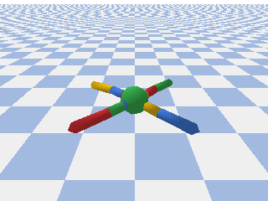
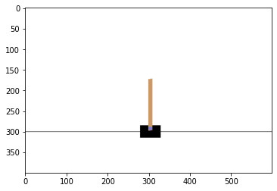
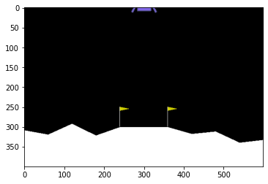
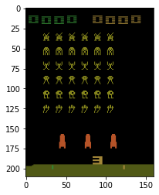
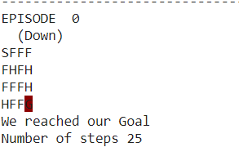
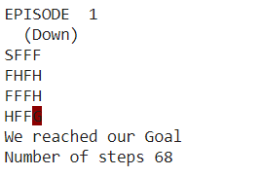
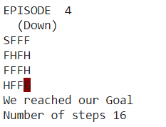
Simulation
RL
Stable baselines library
Using PPO2 model (Proximal Policy Optimization) from the stable baselines library
Using PyBullet rendering environment
Using OpenAI gym
Own implementation
…
Implemented Q-learning
Using OpenAI gym- frozen laken environment

Slide 9
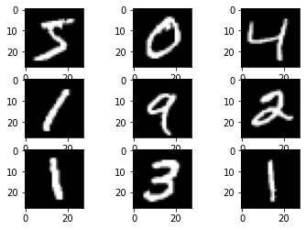
Simulation
ES
Currently working on Training a Neural Network using Evolution Strategies for the “MNIST Handwritten Digit dataset”
After training for 50 iterations the cross-entropy loss was ~ 0.3 (This was kind of constant for 26 iterations already, then it stagnated).
We compared these results to those using a single neural network with backpropagation

Slide 10
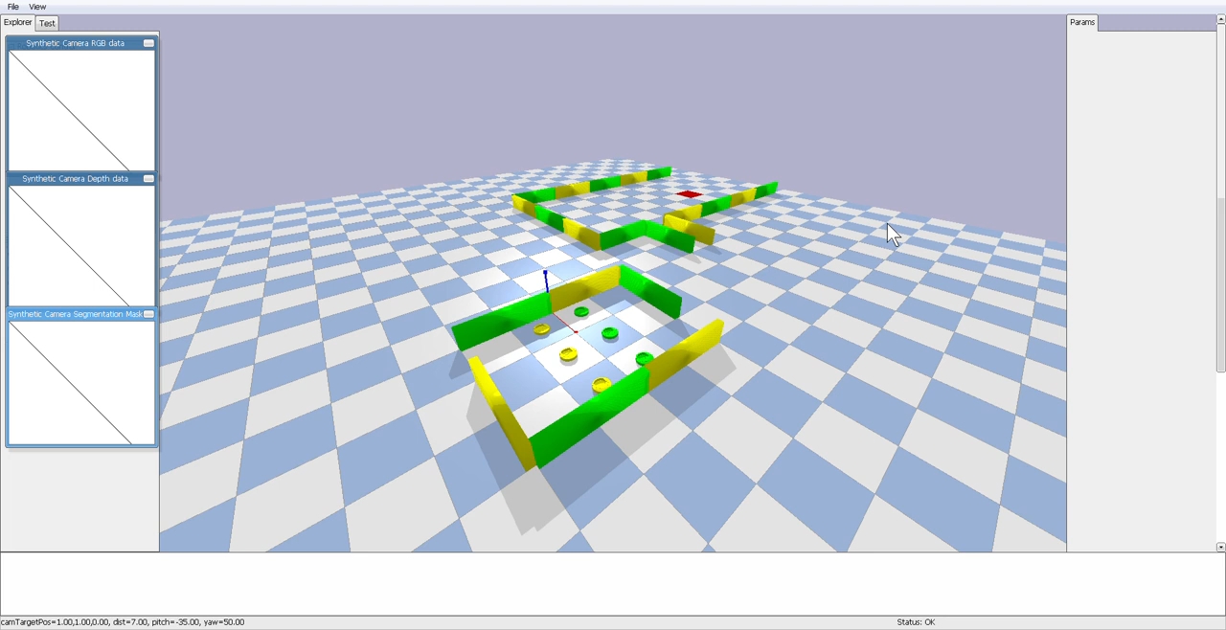
Interesting simulations
Simulation of 6 wheeled robots in PyBullet for navigating in an environment
Create a square formation in the original arena
Switch to a different formation to cross the narrow passages. In all formations, keep at least 1m between each robot
Navigate through the environment, avoid obstacles and reach the goal
Create a triangle formation once the goal has been reached
Notes:
https://github.com/swapnesh-wani/swarm_robotics/blob/master/Project/Project%20Problem.pdf
https://github.com/duckietown/gym-gazebo
https://essay.utwente.nl/79790/1/Zeng_MA_EEMCS.pdf
https://github.com/m5823779/MotionPlannerUsingDDPG
https://arxiv.org/pdf/2005.13857.pdf

Slide 11
Setting up the thesis plan
The thesis is 45 Ects (1 Ects = 28 hrs). This means that you are expected to complete your thesis in approximately 30 wks. This is full-time and excluding holidays, illness etc. Tip: take your holidays into account in the planning
In my case the thesis is 40 credits which should amount to around 26 weeks of work ~ 6 month
Start graduation project
Kick-off session (wk 1-3)
Mid Term Review (wk 13-14):
Green light review (wk 24):
Expected hand in date thesis (wk 26):
Expected Master Thesis presentation and defense (wk 27):

Slide 12
Next Steps
ES multi agent- Deep Dive:
Efficacy of Modern Neuro-Evolutionary Strategies for Continuous Control Optimization
Evolving autonomous specialization in congested path formation task of robotic swarms
Robust Swarm Robotics System Using CMA-NeuroES with Incremental Evolution
Evolving autonomous specialization in congested path formation task of robotic swarms
A Parallel Evolutionary Algorithm with Value Decomposition for Multi-agent Problems
Evolving Collective Cognition of Robotic Swarms in the Foraging Task with Poison
A Study of the Impact of Evolutionary Strategies on Performance of Reinforcement Learning Autonomous Agents
Robust Optimization through Neuroevolution
Model-Based Stochastic Search for Large Scale Optimization of Multi-Agent UAV Swarms
Fully Distributed Multi-Robot Collision Avoidance via Deep Reinforcement Learning for Safe and Efficient Navigation in Complex Scenarios
Simulation:
Evolutionary Predator-prey Robot Systems: https://github.com/chenjiunhan/Predators_and_Prey/
Try to create my own environment in Pybullet: https://github.com/utiasDSL/gym-pybullet-drones
https://github.com/hardmaru/estool
Collision Avoidance- Deep Dive:
Go over the main papers found on the topic

Slide 13
References
https://techxplore.com/news/2019-08-evolutionary-robotics-approach-robot-swarm.html
When Mating Improves On-line Collective Robotics- Amine Boumaza

